Slide 1
Overview of BigData and
Apache Spark

Slide 2
Outline:
Big Data and its challenges
Introduction to Apache Spark and History
Apache Spark (vs) Hadoop MapReduce
Apache Spark Architecture
Apache Spark Internals
Spark job execution modes

Slide 3
Objectives:
At the end of this lesson, you will be able to understand:
  Big Data and challenges with Big Data
  Apache Spark and its architecture
  Differences between Apache Spark and Hadoop MapReduce
  Apache Spark job execution modes
  How Spark works with cluster manager to execute the job

Slide 4
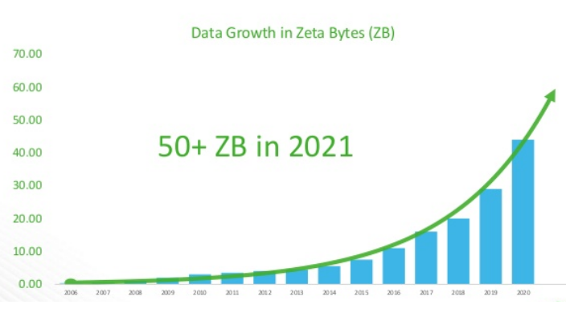
What is BigData?
Now a days, getting data from many data sources:
  User Generated Content
    Twitter, Facebook
    ClickStream
    Payment Apps
  Internet of Things (IOT):
    Industrial Sensors, Wind Turbines
    Fitness Wearables

Slide 5
“Big Data” problem:
Problem:
  A single machine cannot store or process all the data.
Solution:
  Distribute data over large clusters.
Difficulty:
  How to store the huge data across machines?
  How to split the work across machines?
  How to deal with failures?

Slide 6
What is Apache Spark?
Apache Spark is a unified computing engine and a set of libraries for parallel data processing on computer clusters.
  Unified: Can do variety of tasks such as simple data loading, SQL queries for analyzing data, machine learning, stream data processing etc.
  Computing engine: Spark handles loading data from storage systems and performs computation on it
  Libraries: Spark includes libraries for SQL and structured data (Spark SQL), machine learning (MLlib), stream processing (Spark Streaming and the newer Structured Streaming), and graph analytics (GraphX).
Spark supports multiple widely used programming languages (Python, Java, Scala, and R).

Slide 7
History of Spark:
Apache Spark began at UC Berkeley in 2009 as the Spark research project by Matei Zaharia.
At the time, Hadoop MapReduce was the dominant parallel programming engine. But MapReduce framework has drawbacks as it has to store intermediate data on disk and this will impact the performance of ML applications.
Apache Spark community released Spark 1.0 in 2014 and Spark 2.0 in 2016.

Slide 8
Spark (vs) MapReduce:
 | Map Reduce | Spark
Data Processing | Only for Batch Processing | Batch Processing as well as Real-Time Data Processing
Processing Speed | Slower than Spark because of I/O disk latency | 100x faster in memory and 10x faster while running on Disk
Complexity | Difficult to write and debug | Easy to write and debug
Coding | More lines of code | Lesser lines of code
Languages Support | Primary language is JAVA, but also supports C, C++, Ruby, Python, Perl, Groovy | Supports JAVA, Scala, Python and R
Interactive Mode | Not interactive | Interactive
Ease of Use | Bit complex comparing Apache Spark because of Java APIs | Easier to use because of rich APIs
Fault Tolerance | Uses data replication for fault tolerance | Uses RDD and other data storage models for fault tolerance
Costs | Less costlier | More costlier because of large amount of RAM

Slide 9
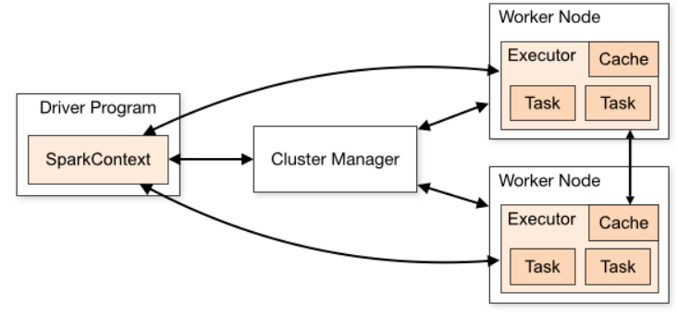
Spark Architecture:
Spark manages and coordinates the execution of tasks on data across a cluster of computers.
  Driver Program – Manages the Spark application and assigns the tasks to executors.
  Cluster Manager – Manages the cluster resources and grants resources to submitted Spark application
  Executors – Will do the actual work

Slide 10
Spark Architecture:
Spark application consists Driver process and Executor processes,
Driver process:
  Driver process runs your main() function and it sits on a node in the cluster
  It’s the heart of a Spark application and maintains all the information about your application
  This process is responsible for,
    Managing information about your Spark application
    Responding to user’s program or input
    Distributing and scheduling the work across the executors
Executor process:
  Executor processes will do the actual work and sits on worker nodes in a cluster.
  They are responsible for,
    Executing the code assigned by the Driver
    Reporting the state of computation back to the Driver

Slide 11
Execution Modes:
An execution mode gives you the power to determine where the aforementioned resources are physically located when you go to run your application.
  Cluster mode
  Client mode
  Local mode

Slide 12
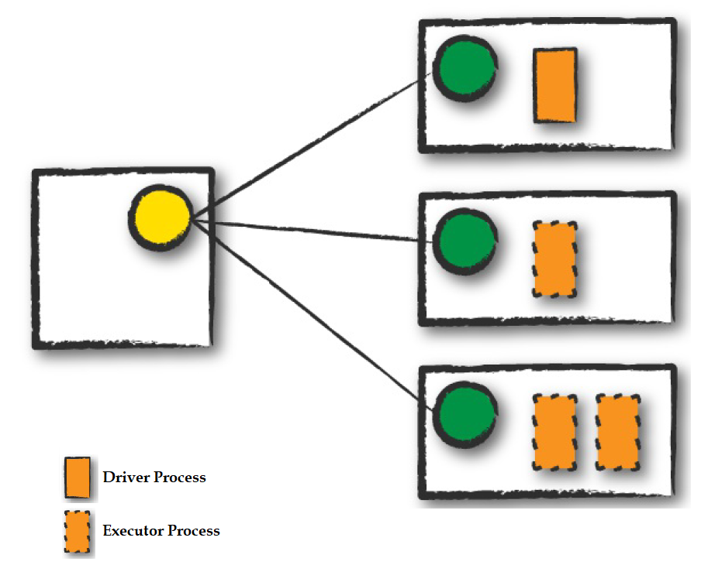
Execution Modes:
Cluster Mode:
  In cluster mode, a user submits a pre-compiled JAR, Python script, or R script to a cluster manager.
  The cluster manager then launches the driver process on a worker node inside the cluster, in addition to the executor processes.
  Cluster manager is responsible for maintaining all Spark Application related processes.
  Cluster manager places driver on one worker node and the executors on other worker nodes.

Slide 13
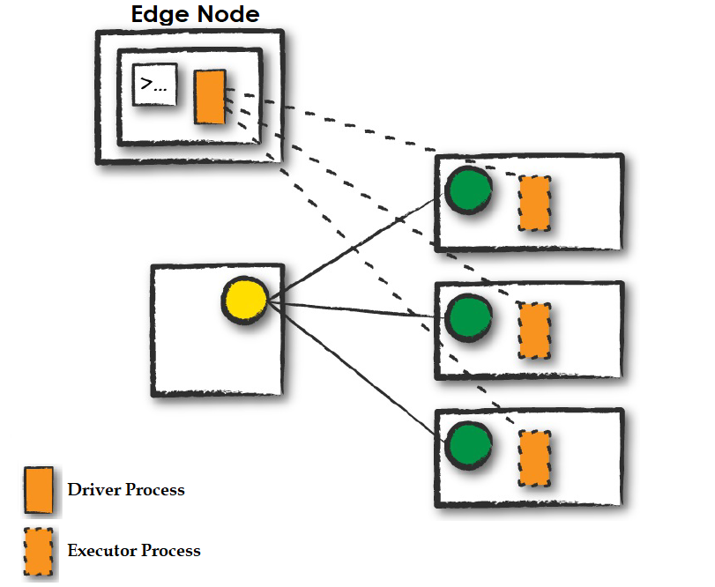
Execution Modes:
Client Mode:
  Similar to cluster mode, but Spark driver process remains on client machine that submitted the application.
  Client machine is responsible for maintaining the Spark driver process, and the cluster manager maintains the executor processes.

Slide 14
Execution Modes:
Local Mode:
  Local mode runs the entire Spark Application on a single machine.
  It achieves parallelism through threads on that single machine.
  This is a common way to learn Spark, to test your applications, or experiment iteratively with local development.
  This mode is not recommended for Production Spark applications.

Slide 15
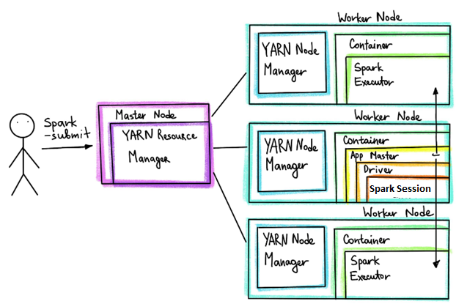
How Spark runs on a cluster?

